Slide 1

Selling New
Construction

Slide 2
New Construction
Almost all new construction transactions require more involvement on the part of an agent than resale transactions, and, often, the commission rates are lower.

Slide 3
Negotiating New Construction
Typically there is not as much negotiation with new construction as there is with resale. Part of the reason is when you negotiate 5% with new construction the 5% may represent 33% of the profit.
If builders have other homes they are selling in the same development/community, negotiating the price down affects the sales price of their other future properties. In lieu of negotiating down they may offer to pay for upgrades or give closing cost credits.
  “The buyers shall receive a credit towards closing costs and prepaids at the time of the closing in the amount of $23,792.00.”
Time is money. Every day a builder has a home sitting on the market is a day they are losing money.
If a builder has inventory sitting as a stand alone house it will be easier to negotiate if that new home has been sitting on the market.
I always research the builder to see if they have negotiated the sales price of other homes they have built. I do this for homes within a given development/community, as well as, for stand alone spec homes.

Slide 4
New Home Communities
First buyers may get the best discounts because early in the sales process builders want to get some homes under contract quickly.
If a builder can announce they have 8 homes under contract in a few weeks, the project can seem more desirable to future buyers.
The builder can increase prices after a certain number of homes are under deposit or in the next phase.
The last phase could end up being priced 10% or more higher than phase one.

Slide 5
Representing a Buyer
The process is not straight forward
Lot location
Floor plan
Specifications

Slide 6
Offer
Obligation to purchase is subject to formal contracts being executed.
Obligation to purchase is subject to seller and buyer agreeing to a final house plan, specifications, and price. House plans and specifications are to be included in the contract of sale.
Purchaser shall have the right to perform a building inspection at their expense, prior to closing. The seller is responsible for only repairing those items that are not in compliance with the local building codes.
Purchaser shall have the right to perform a radon inspection at their expense, prior to closing. If the results are not in compliance with the EPA minimum standard of 4.0, seller will be responsible to install at the seller’s expense a radon mitigation system to bring the test results in compliance with the EPA standard.

Slide 7
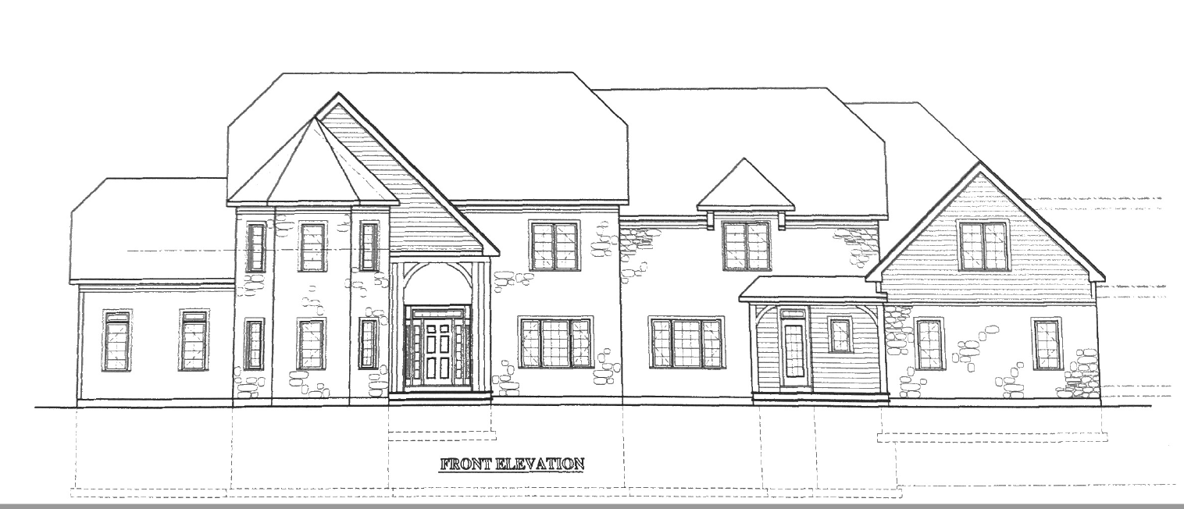
House Plans – Front Elevation

Slide 8
House Plans – Front and Rear Elevations

Slide 9
House Plans – Left and Right Side Elevations

Slide 10
House Plans - Garage

Slide 11
House Plans - Foundation

Slide 12
House Plans - First Floor

Slide 13
House Plans - Second Floor

Slide 14
Specifications
Every Builder is different. What is standard for one might be an upgrade for another.
In new home developments with model homes, many times options/upgrades are shown and you need to make sure your clients know these upgrades come at a cost.

Slide 15
Specifications for Constructions
Easton Woods 2, Easton, Ct
General Specifications
General Conditions
Site Work, Driveway, Landscaping
Foundation and Concrete
Moisture protection
Insulation and Ventilation
Masonry
Metals
Carpentry
Roofing
Drywall
Windows, Doors, Staircases and Millwork
Electrical
Exterior/Interior Painting and/or Staining
Flooring
Cabinetry and Appliances
Plumbing
Heating and Air Conditioning
Miscellaneous

Slide 16
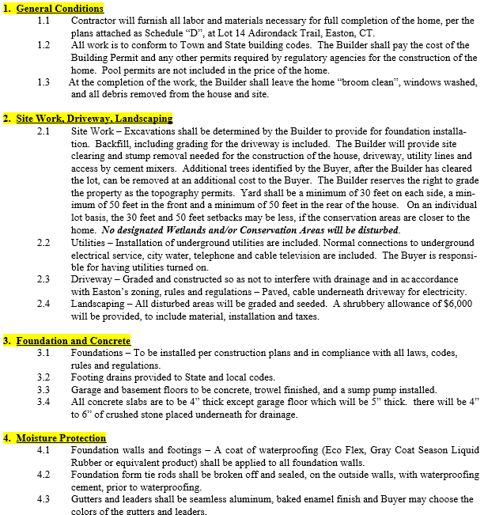
Specifications for Constructions

Slide 17
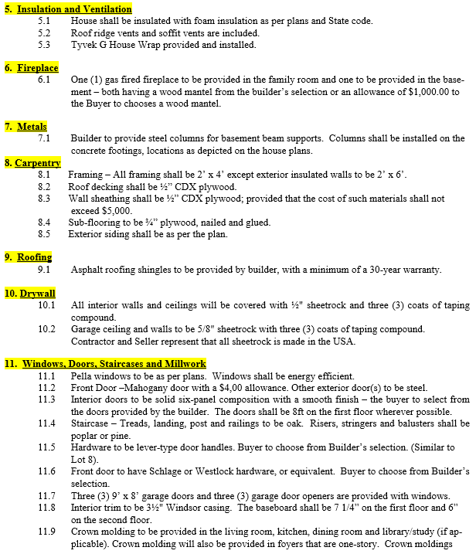
Specifications for Constructions

Slide 18
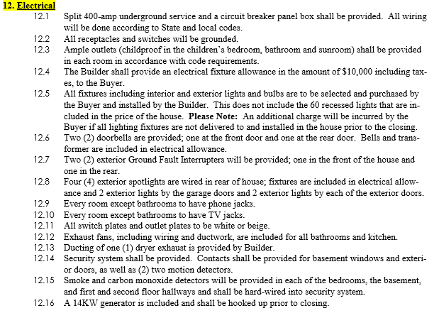
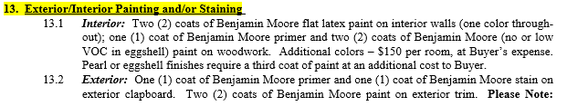
Specifications for Constructions

Slide 19
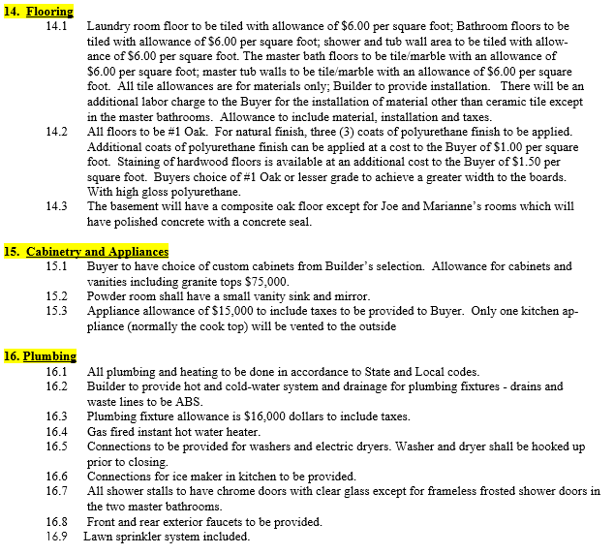
Specifications for Constructions

Slide 20
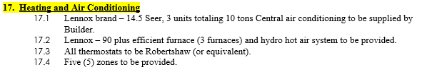


Specifications for Constructions

Slide 21
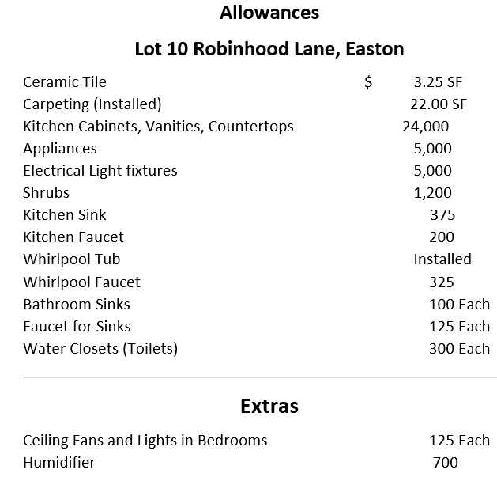
Specifications for Constructions - Allowances

Slide 22
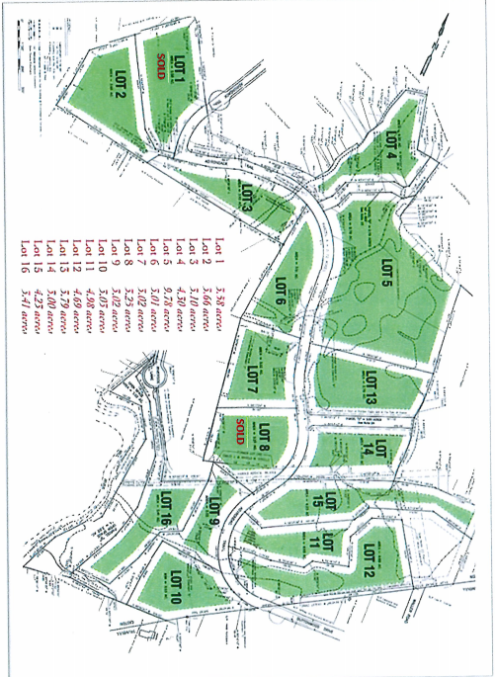
Site Plan

Slide 23
Site Plan

Slide 24
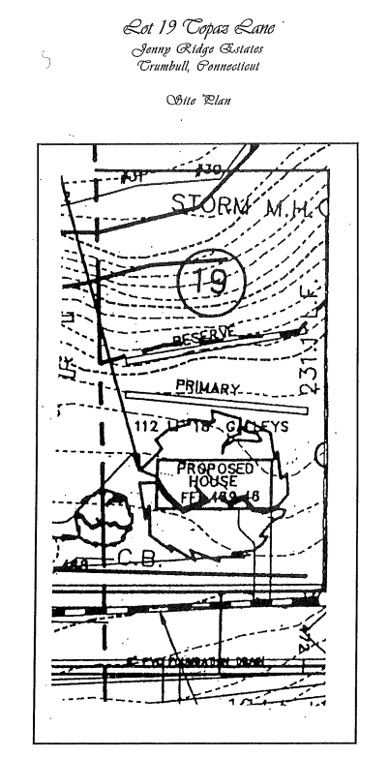
Septic Plan if Applicable

Slide 25
Septic Plan if Applicable

Slide 26
Septic System As-Built

Slide 27
House As-Built

Slide 28
Declaration of Restrictions and Covenants
It is the objective of the declarant to ensure that the premises contains a variety of tastefully designed traditional homes of high quality of at least 3,800 square feet of living space exclusive of the basement, garage, or outside porches. The primary purposes of the restrictions and specifications set forth in this document is to convey an overall impression of the general quality level required in homes to be constructed and at the time to provide maximum flexibility for each lot owner to exercise individual creativity and personal taste.
All rules and regulations under the zoning ordinances of the Town of Easton, applicable to the premises, shall be observed and complied with.
The Lots shall be used and occupied for residential purposes only.
No poultry or domestic animals except a total of two dogs or cats (not two dogs and two cats) may be kept maintained on a Lot, and they shall be quartered within the family dwelling at night.

Slide 29
Declaration of Restrictions and Covenants
5. The following additional building restrictions shall apply:
    Garages and Other Detached Structures
      Design and detailing shall be residential in character and in same style as the main house.
      Must provide space for no less than three (3) automobiles side by side.
      Door height may not exceed 8’3” unless Declarant’s written approval is obtained.
    Foundations:
    No bare concrete foundation or footing may be left exposed more than 12 inches above grade. All such surfaces shall be faced with stone, brick, earth tone stucco or other material as may be approved by Declarant.
    c. Driveways:
    Shall be constructed with processed traprock, asphalt, cobblestone or brick pavers. Any other material must be approved by Declarant.
    d. Pool and Tennis Court:
    A pool or a tennis court must have its site approved by Declarant.
    e. Walkways:
    All walkways shall be stone, flagstone, Belgian block or brick. Any alternative material must be approved by Declarant.

Slide 30
Declaration of Restrictions and Covenants
    f. Outside Storage:
    No lot shall be used for the out-of-doors storage of any of the following: house trailers; camping trailers including boat trailers, self-contained camping vehicles; commercial vehicles of any type whatsoever, whether registered or not; junked motor vehicles of any type; aluminum sheds; boats; non-registered automobiles; motorcycles, motorbikes, minibikes, snowmobiles, ATVs or similar vehicles; mobile homes; tractors; buses; vehicles with advertising.
    g. Chimneys:
    All chimneys are to be constructed of stone, brick, or stucco. When brick chimneys are used, they will be tastefully or creatively detailed.
    All construction including driveways, fine grading and seeding of all disturbed areas shall be completed no later than eighteen (18) months from the date construction begins.

Slide 31
Declaration of Restrictions and Covenants

Slide 32
Declaration of Restrictions and Covenants

Slide 33
Declaration of Restrictions and Covenants

Slide 34
Declaration of Restrictions and Covenants

Slide 35
Declaration of Restrictions and Covenants

Slide 36
Declaration of Restrictions and Covenants

Slide 37
Declaration of Restrictions and Covenants

Slide 38
Declaration of Restrictions and Covenants

Slide 39
Warranties
In CT there is a statutory one-year warranty with all new home construction.
Additionally, there are items like roof, appliances, hot water heater, etc. that have much longer warranties.
Sometimes a builder uses a third – party warranty company for other components of the house.
At the time of closing, you should receive all warranty information.

Slide 40
Basement Water

Slide 41
Contract Warranty Language

Slide 42
Statement of Non-Warrantable Conditions (From Seller’s Attorney)

Slide 43
Statement of Non-Warrantable Conditions (From Seller’s Attorney)

Slide 44
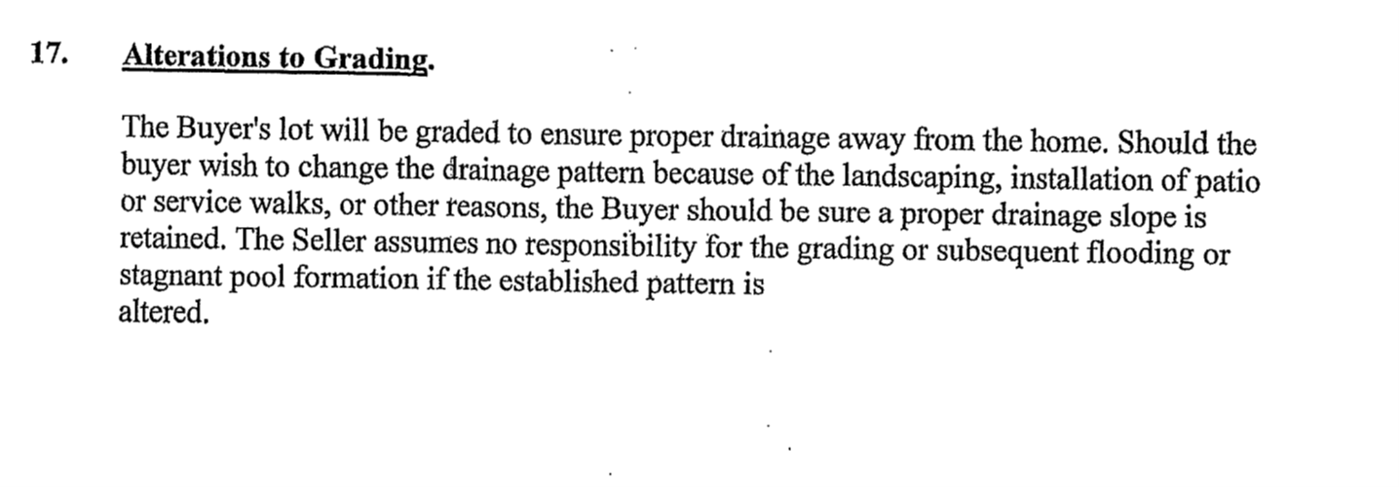
Statement of Non-Warrantable Conditions (From Seller’s Attorney)

Slide 45
Get The Home Inspected
Even though most municipalities require new homes to pass permit inspections you should still recommend a home inspection.
I write in the offer that the builder agrees to repair code compliance issues, but the buyer would not have the option to walk away from the deal.

Slide 46
Building Inspection Punch list items

Slide 47
New Construction Addendum to Contract ( From Buyer’s Attorney)

Slide 48
New Construction Addendum to Contract ( From Buyer’s Attorney)

Slide 49
New Construction Addendum to Contract ( From Buyer’s Attorney)

Slide 50
Contract to Purchase
Hopefully the buyer’s attorney is a real estate attorney who has experience with new construction. The new construction purchase contract has all the same things you find in a resale contract plus the following:
CT Department Consumer Requirements for New Home Construction Contracts

Slide 51

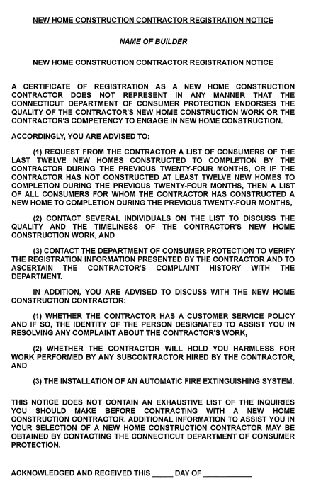


Slide 52
A copy of the Contractor’s New Home Construction License – not just the license number but actual copy of the license – is to be attached to the contract.

Slide 53
•The following statement must be included in the
contract:
The Buyer acknowledges that Buyer may be contacted by future customers of the Contractor regarding the timeliness and quality of the Contractor's work, unless the Buyer indicates in writing at the time of execution of this contract that Buyer prefers not to be contacted.

Slide 54
•The following statement must be included in the
contract:
The Buyer acknowledges that Buyer may be contacted by future customers of the Contractor regarding the timeliness and quality of the Contractor's work, unless the Buyer indicates in writing at the time of execution of this contract that Buyer prefers not to be contacted.

Slide 55
DCP – New Construction Website Link
•This is the link to the website. In addition to allowing you to look up, and verify, a contractor’s license, this website provides other helpful information and resources.
https://portal.ct.gov/DCP/Trade-Practices-Division/New-Home-Construction-Information-for-Consumers

Slide 56
Other Contract
Additions

Slide 57
Contract of Sale - Schedule A - I
Schedule A - Legal Description
Schedule B - Seller and Contractor
Schedule C - Declaration of Restrictions and Covenants
Schedule D - Plans
Schedule E - General Specifications
Schedule F - Statement or Non- Warrantable Conditions
Schedule G - Allowances
Schedule H - General Indemnity : First American Title Insurance Company Waiver of Mechanic’s Liens, General Contractor’s Affidavit and Indemnity Agreement, Owner’s Affidavit and Indemnity Agreement
Schedule I - Buyer’s Attorney New Construction Addendum to the Contract

Slide 58

Varies by the customs of the different counties throughout CT and by the builder or developmental project.
At contract signing time most builders would like to have their full financing down payment if it is less than 10%. If the down payment is greater than 10%, they require 10%.
If changes are made during construction especially with upgrades many times the builder will require 50% or greater of the upgrade cost paid at the time the change has been ordered.

Slide 59

Determine who to communicate with during construction if the buyer has questions/concerns and who to communicate with after the closing for questions/concerns.

Slide 60
Changes Additions
All changes, additions, and/or verbal agreements need to be put in writing.

Slide 61
Extras

Slide 62
Commission Calculation For Extras
**Must Be Spelled Out
3. Purchase Price: The “Purchase Price” is ONE MILLION SIX HUNDRED SEVENTY-TWO THOUSAND DOLLARS ($1,672,000.00) payable as follows:

Slide 63
Commission Calculation For Extras
Second Floor Deck $5,600.00
High-Hats $14,000.00
Front Door $2,800.00
Coffer Ceiling Library $4,400.00
Move partition and rebuild Jack & Jill Bathroom & Plumbing $1,600.00
Remove Partition in Basement, and move Pocket Doors in Sophie’s Room (Bathroom and Closet) $10,000.00
Extra Window Transoms $4,600.00
Belgium Block Driveway (600 lf.) $11,000.00
Extra Paving (3,000 sf.) $12,000.00
Extra Tiles $6,200.00
Extra Toilet Fix $10,269.59
Kitchen Cabinets & Vanity (Library) $80,000.00
(2) Piers on Wing Walls $5,400.00
Pizza Oven with Cook Tops $18,000.00
Insulation in Attic Only $3,600.00
Retaining Walls, Grills, & Patios $82,000.00
Repaint Stair Rails $3,700.00
Upgrade Rail Post $2,400.00
Floor Stain $8,250.00
Appliances $29,926.29
Extension of Lower Patio & Wall $14,270.00
Installation of Medicine Cabinets $600.00
Remove Mirrors $425.00
Front Door (Extra) $2,200.00
Granite Counters (all) $32,000.00
Closet Shelving (all) $27,250.00
Electrician (extra work) $1,400.00
TOTAL: $393,890.88
Allowance Items: $244,995.88
Masonry: $130,670.00
Changes: $18,225.00
*It must be clear in MLS, in the Sales Contract and with the Listing Agent and the Builder.

Slide 64
Final Walk Thru
Find a way to mark any items that need to be addressed. Take photos and follow-up in writing with the builder, the buyer, the attorneys, and the realtors.

Slide 65


Slide 66
Closing Date
Closing dates sometimes are a challenge: Weather, Municipal Inspections, Contractors, Materials, Lender Timing, Certificate of Occupancy.

Slide 67
Builder Financial Strength
During the market crash many builders/developers were in financial trouble.

Slide 68
Researching the Builder
Visit other developments
Talk to homeowners
Search online for reviews, testimonials, and news

Slide 69
Waiver of Mechanics

Slide 70
Waiver of Mechanics

Slide 71
Waiver of Mechanics

Slide 72
Buyers Bypassing an Agent
Some buyers believe that if they go directly to the builder, they will reduce their home price.
Builders do not want to lower prices as it will have an impact on future sales.
Builders sign agreement expecting to pay commissions as it is more important that realtors know they will get paid vs saving on a few commissions.
Many times the builder will just turn to his/her listing agent and hand over the customer and they will get paid the commission.

Slide 73
Selling a home that has not been started: Custom
Things that need to be addressed:
A) Does the builder or buyer have a plan that works for the budget
B) If an architect or designer is required who will pay the design fees
C) How does the lot get secured - deposit, letter of intent, MLS form
D) Once a plan, specifications, and price are agreed to then the previously discussed new home contract can be drafted and executed

Slide 74
Bringing a Builder a New Home Client Opportunity for a Custom Home
A) All of the same apply from the previous slide
B) You need to make sure you have a conversation with the builder about the commission you are looking to be paid, and put in place a signed commission agreement, prior to your client meeting with the builder.

Slide 75
New construction purchase financing for a spec home that can be delivered in 60 days:
Everything is typically the same as if you were purchasing an existing house except the appraiser will need a copy of the house plans, the specifications, and the contract of sale.
If the house is not completely finished the appraiser will need to come back out prior to closing to verify exactly what the contract says is being included.

Slide 76
New construction financing for a home that cannot
be delivered for 90-360 days:
The bank will do a preliminary appraisal from the plans and specifications, and the appraiser will need to come back out prior to closing to verify exactly what the contract says is being included.
The bigger challenge is a builder will not typically start building a custom house without having a contingent-free contract. As we know financing can be locked in for 60 days, so the buyer has to be willing to waive their mortgage contingency and put deposit money at risk.

Slide 77
Representing a Builder Purchasing a Lot:
Work Backwards:
A) What price can you sell in the existing market?
B) What is the square footage of the house, the style, the level of finish--how much will it cost to build?
C) What builders fee and/or profit do they require?
D) If you know the answers to A, B, and C then you can calculate how much a builder can pay for a lot.

Slide 78
Representing a Builder Purchasing a Lot (Cont’d):
Other factors to consider:
A) The ideal product is something that is in the low to middle end of the market. Offering a great new home at a low to mid-market price will be very attractive. The high end spec has more risk and more reward.
B) You need to understand features such as kitchen cabinet and room colors that are current, what you need electrically for genius stations, black windows vs white windows, etc.
C) Speculative financing is still limited since the last housing crash so the builder has to self-fund or have investor and/or financing sources available.

Slide 79


Concluding Thoughts
You don’t have to be great to start,
but you have to start to be great.
Joe Sabah

