Slide 1
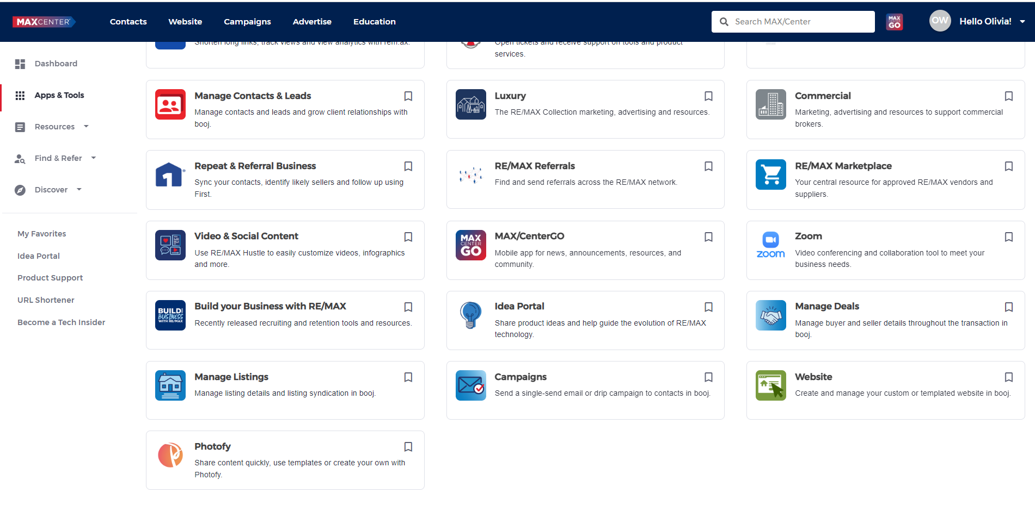
MAX/Center
MAX/Center® is the hub that provides access to all RE/MAX services, support, news and technology. This is also home to your MAX/Profile, where critical information related to your online brand, MLS and service areas are configured.
Visit each of the following resources, which provide valuable information and productivity tools.
○RE/MAX University®
○Support Services
○Megaphone by RE/MAX
○RE/MAX Marketplace
○Tech News
○Marketing Portal
○booj RE/MAX Hustle

Slide 2
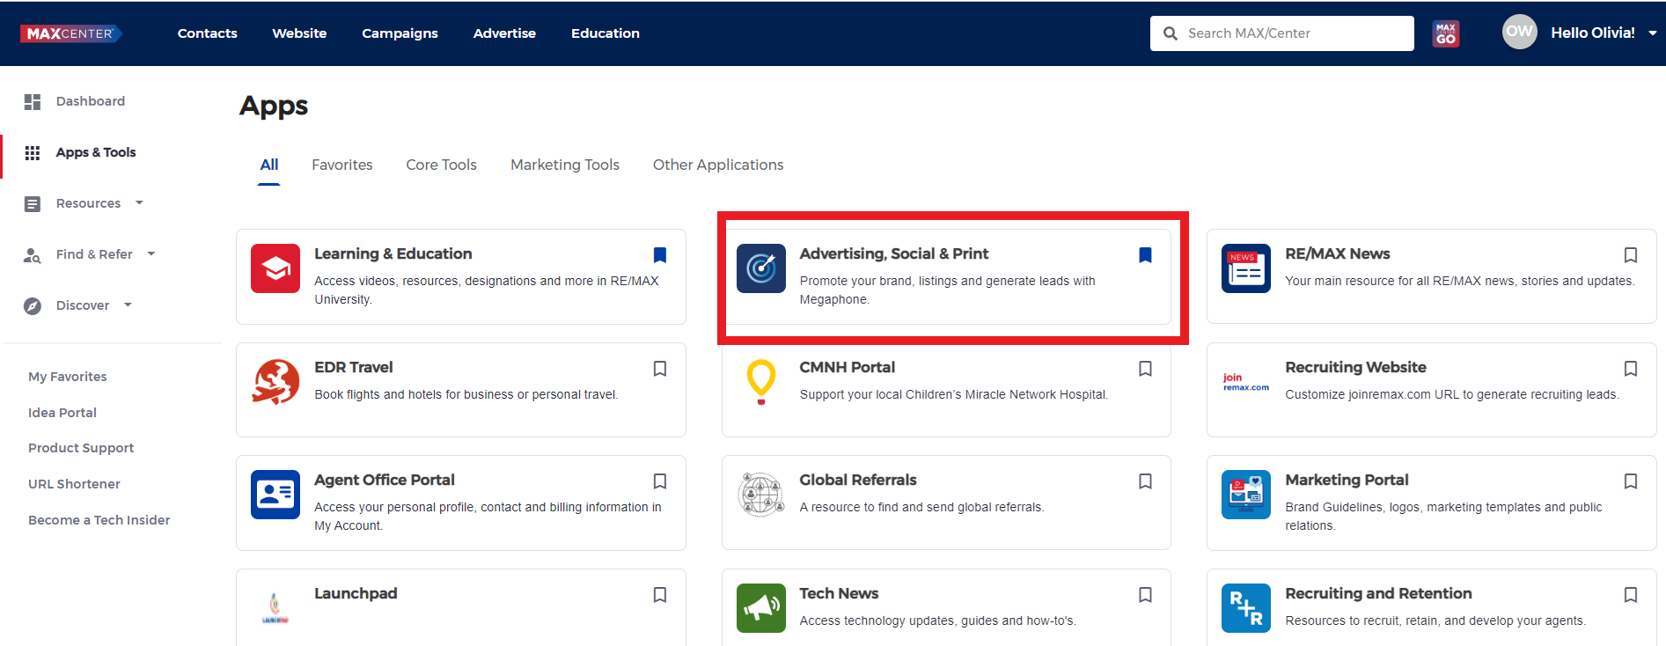
Megaphone
Promote your business and generate leads with this unified marketing and advertising platform. Efficiently promote your brand, build marketing materials and advertise listings—through digital or print—whether at your computer or on the go.

Slide 3
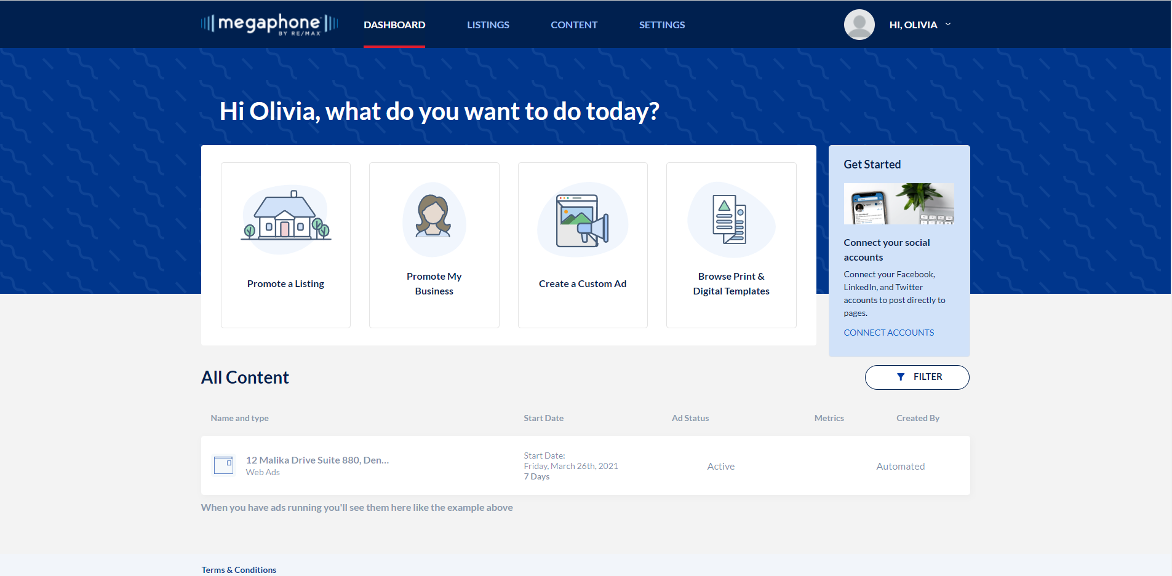
Megaphone
• Automated content: Automated content is generated for active listings

Slide 4
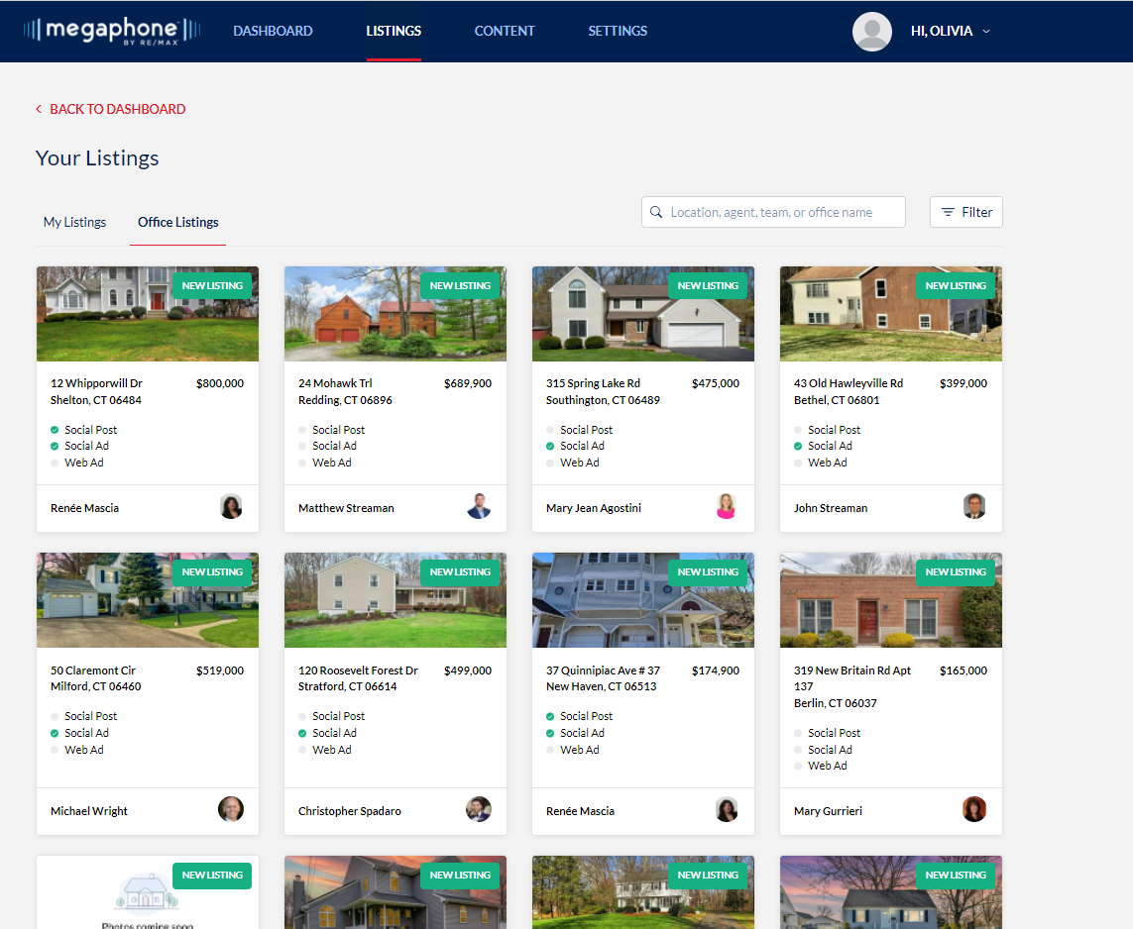
Megaphone Automated Content
• Select the listing you want to work on

Slide 5
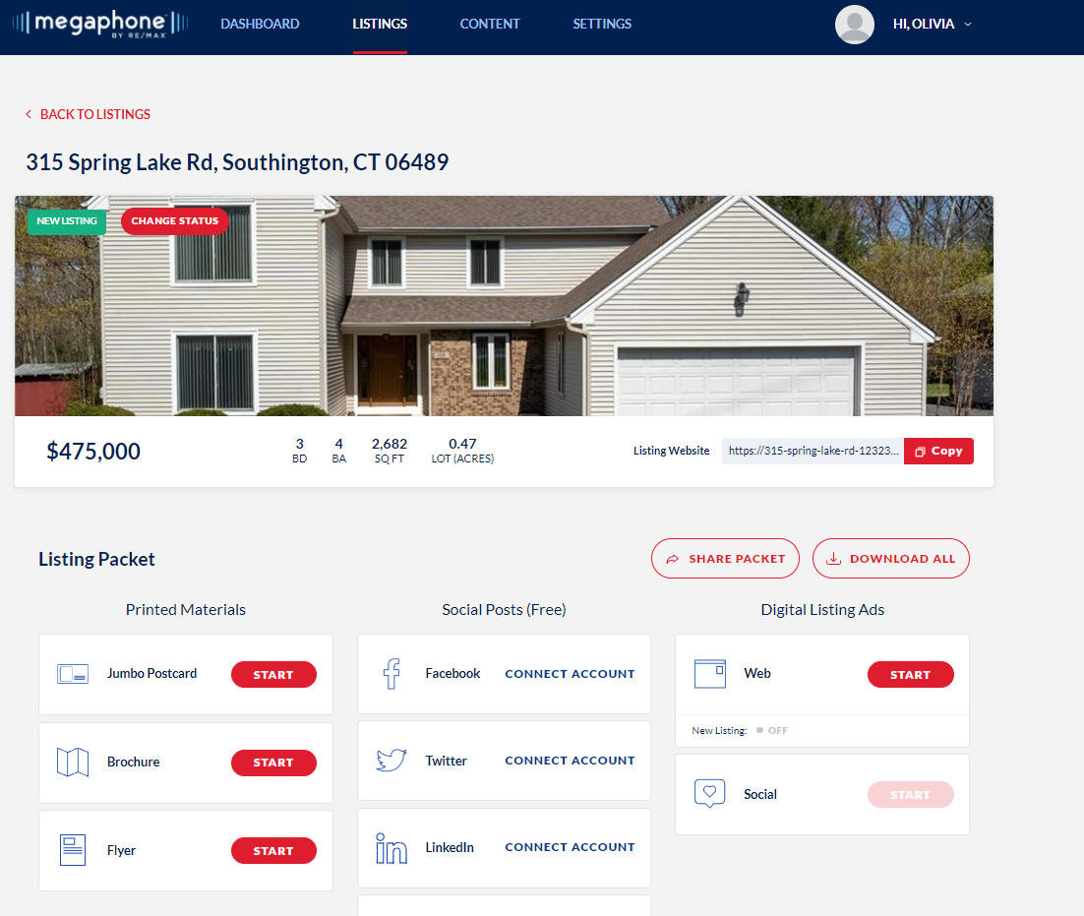
Megaphone Automated Content
• Once you select start you will be able to edit the material as you please. The information is auto populated from the MLS listing.
• Content will also be automatically generated for listings that have closed.

Slide 6
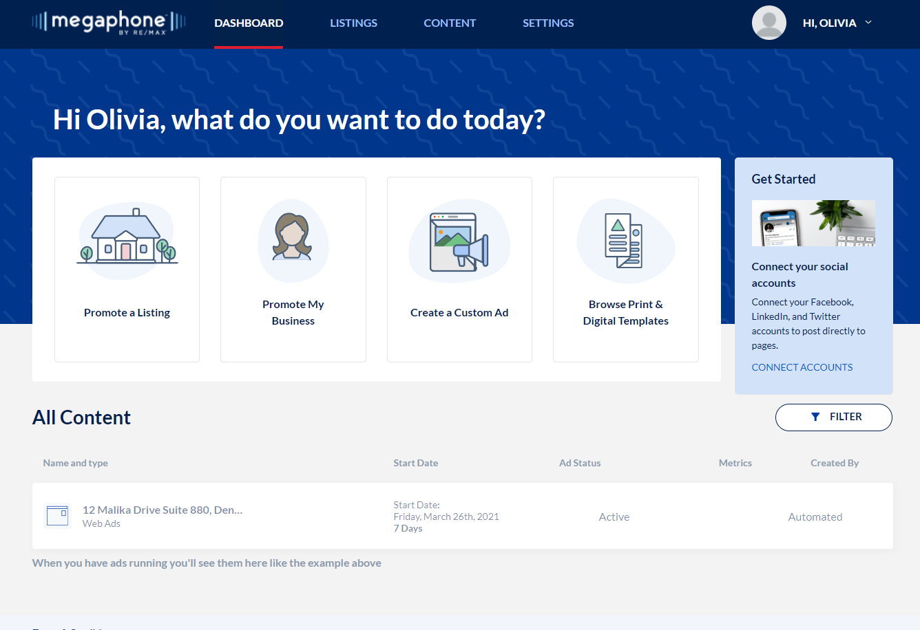
Megaphone

Slide 7
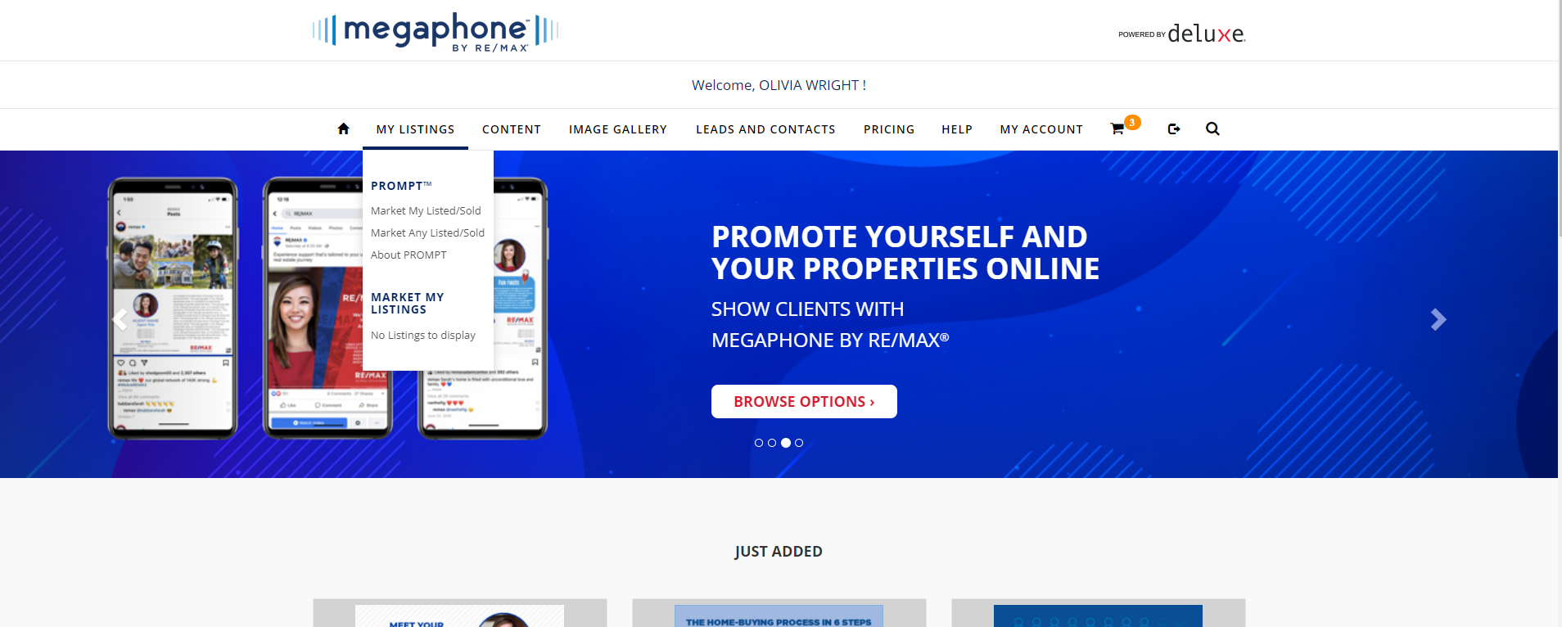
Megaphone

Slide 8
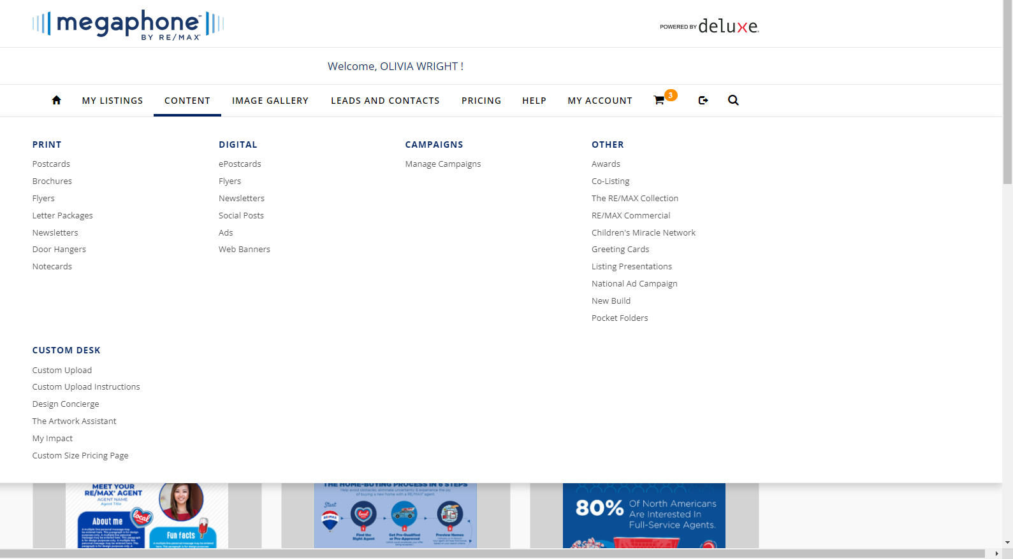
Megaphone

Slide 9
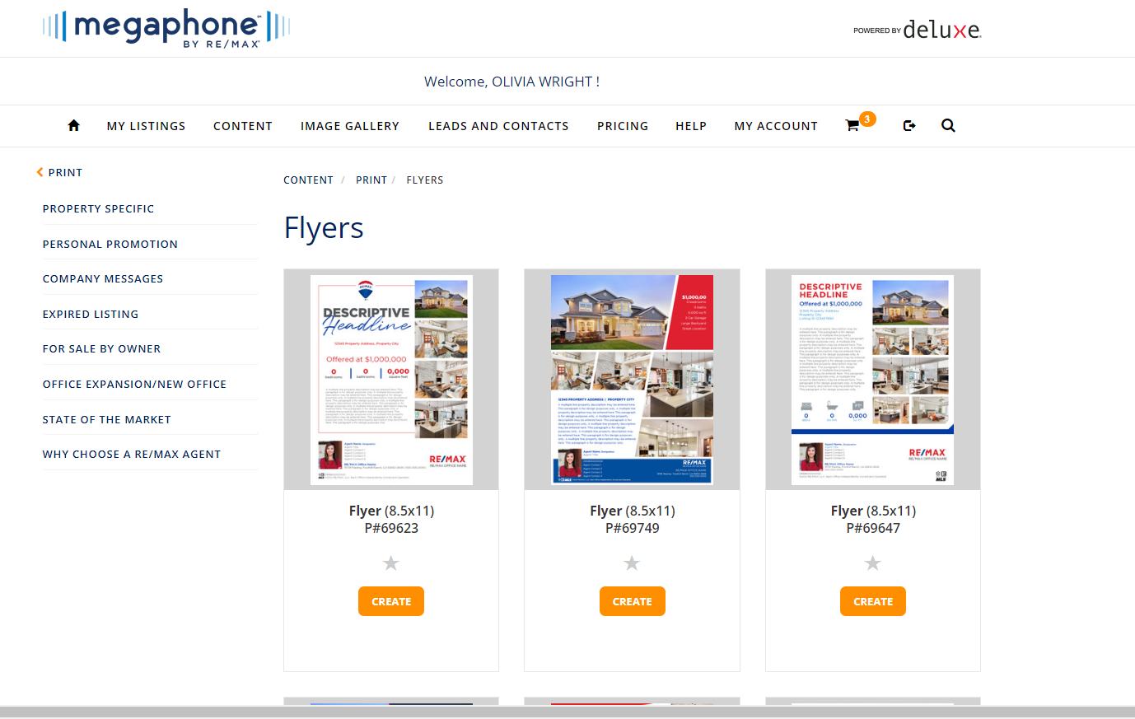
Megaphone

Slide 10
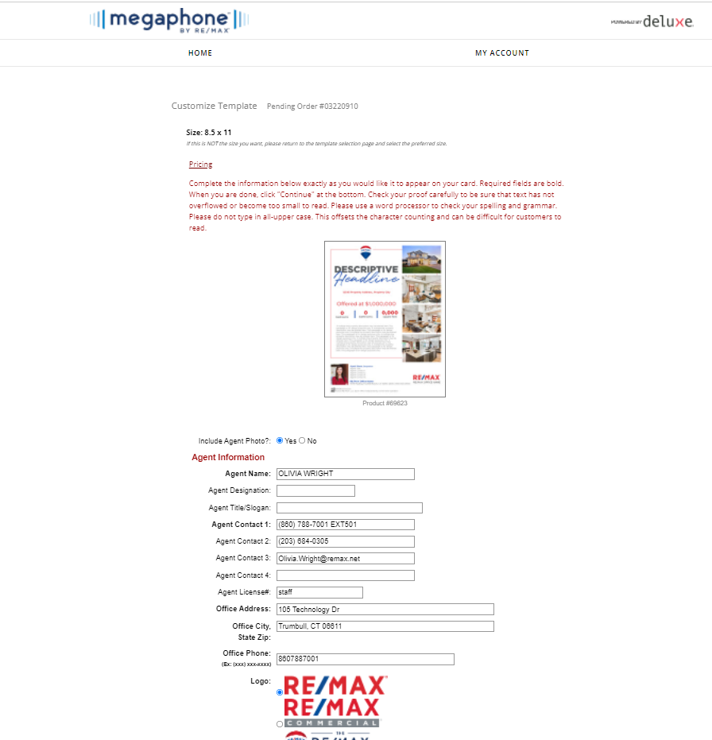
Megaphone

Slide 11
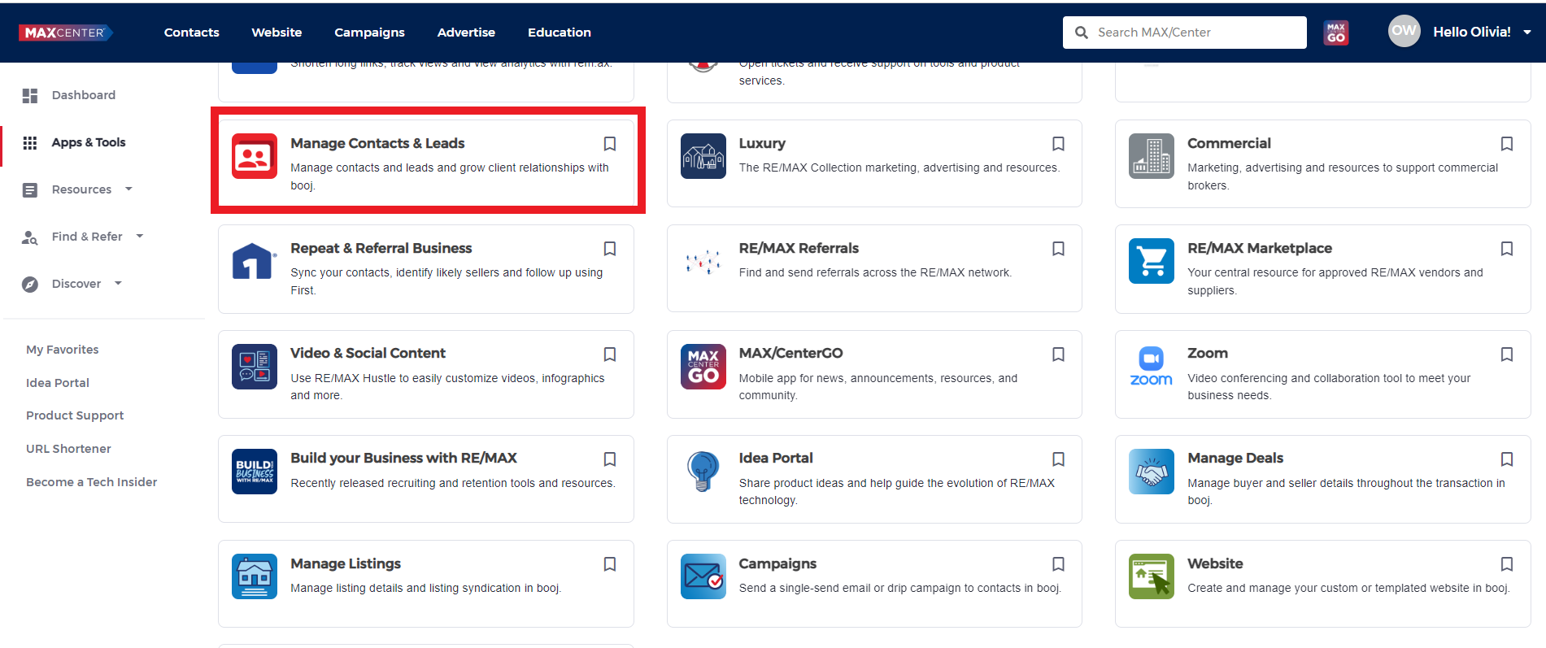
Booj CRM
The Customer Relationship Manager (CRM) is the heart of the booj Platform. The CRM provides powerful tools that enable you to organize and engage with your contacts and leads. Use booj to manage your relationships, track your production and stay on top of all your day-to-day activities.

Slide 12
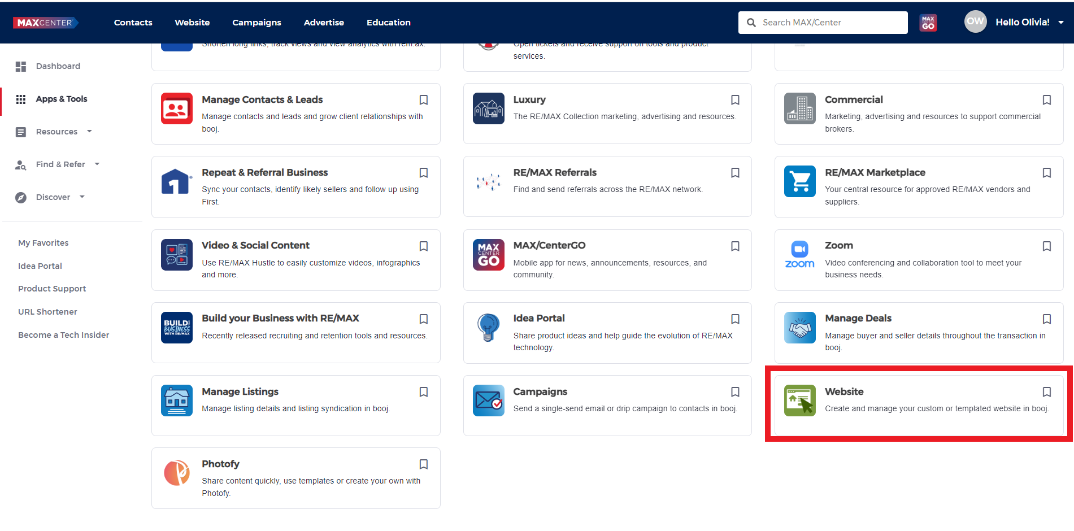
Booj Website
Booj includes a system for creating and publishing a comprehensive real estate website. Each agent, office and team can create and publish a lead-generating site to present their brand, promote their listings and emphasize their market niche

Slide 13

RE/MAX Hustle
Impress leads and delight your clients when you share personalized world-class video. Visit remaxhustle.com on your desktop or mobile device to enhance your advertising, webpages, listing presentations and more—do it all in just a few clicks, and at no additional cost to you!

